Slide 1
Types of production
Yarramsetty Mohan S S Ram

Slide 2
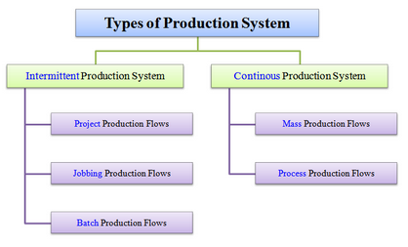
Types of production

Slide 3
Types of production
The types of production system are grouped under two categories viz.,
Intermittent production system, and
Continuous production system.

Slide 4
Intermittent production system
Intermittent means something that starts (initiates) and stops (halts) at irregular (unfixed) intervals (time gaps).

Slide 5
Intermittent production system
In the intermittent production system, goods are produced based on customer's orders. These goods are produced on a small scale. The flow of production is intermittent (irregular). In other words, the flow of production is not continuous. In this system, large varieties of products are produced. These products are of different sizes. The design of these products goes on changing. It keeps changing according to the design and size of the product. Therefore, this system is very flexible.

Slide 6
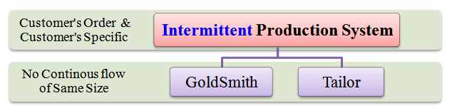
Examples of Intermittent production system

Slide 7
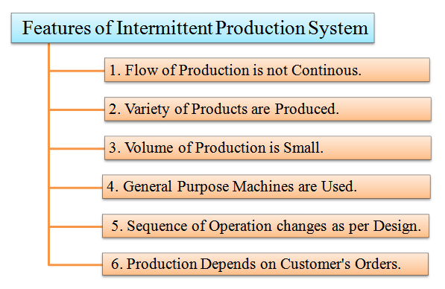
Features of an intermittent production system

Slide 8
The characteristics of an intermittent production system are listed as follows:
The flow of production is not continuous. It is intermittent.
Wide varieties of products are produced.
The volume of production is small.
General purpose machines are used. These machines can be used to produce different types of products.
The sequence of operation goes on changing as per the design of the product.
The quantity, size, shape, design, etc. of the product depends on the customer's orders.

Slide 9
Continuous production system
Continuous means something that operates constantly without any irregularities or frequent halts.

Slide 10
Continuous production system
In the continuous production system, goods are produced constantly as per demand forecast. Goods are produced on a large scale for stocking and selling. They are not produced on customer's orders. Here, the inputs and outputs are standardized along with the production process and sequence.

Slide 11
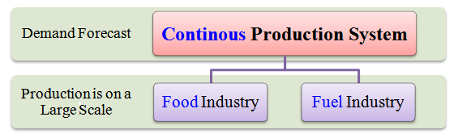
Examples of Continuous production system

Slide 12
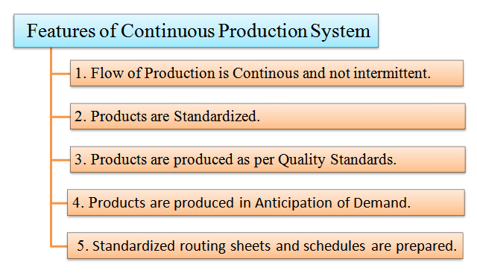

Slide 13
characteristics of a continuous production system are listed as follows:
The flow of production is continuous. It is not intermittent.
The products are standardized.
The products are produced on predetermined quality standards.
The products are produced in anticipation(An expectation) of demand.
Standardized routing sheets and schedules are prepared

Slide 14
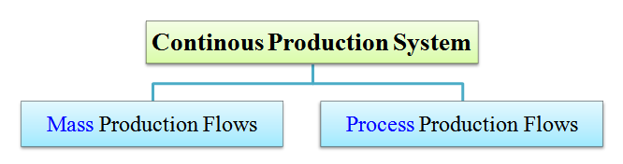
continuous production

Slide 15
1. Mass production flows
Here, company produces different types of products on a large-scale and stock them in warehouses until they are demanded in the market.
The goods are produced either with the help of a single operation or uses a series of operations.
E.g. of mass production is the production of toothpastes, soaps, pens, etc.

Slide 16
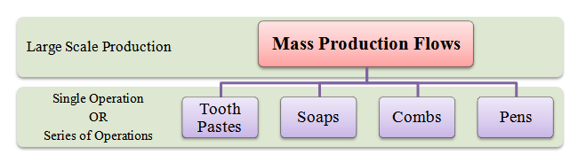

Slide 17
characteristics mass production flows
There is a continuous flow of production. However, this depends on the demand in the market.
Here, there is limited work-in-progress.
Supervision is easy because only few instructions are necessary.
The material handling is done mostly by machines, i.e. conveyors and automatic transfer machines.
The flow of materials is continuous. There is little or no queuing at any stage of production.

Slide 18
Process production flows
Here, a single product is produced and stocked in warehouses until it is demanded in the market. The flexibility of these plants is almost zero because only one product can be produced.
Examples of these plants include, steel, cement, paper, sugar, etc.

Slide 19
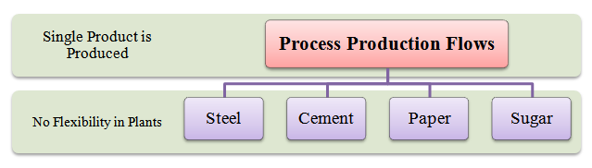

Slide 20
characteristics process production flows
There is a highly mechanized system for handling materials. Conveyors and automatic transfer machines are used to move the materials from one stage to another.
Low-skilled labour and skilled technicians are required.
There is very less work-in-progress because material flow is continuous.
The production planning and scheduling can be decided well in advance.
The full production system is designed to produce only one specific type of item.

Slide 21
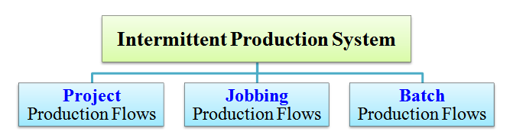

Slide 22
The types of an intermittent production system include:
Project production flows,
Jobbing production flows, and
Batch production flows.

Slide 23
Project production flows
Here, in project production flows, company accepts a single, complex order or contract. The order must be completed within a given period of time and at an estimated cost.
Examples of project production flows mainly include, construction of airports, dams, roads, buildings, shipbuilding, etc.

Slide 24
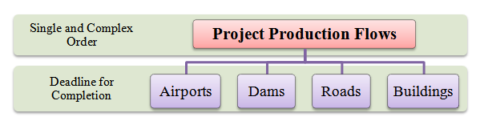
Examples of project production

Slide 25
characteristics project production
The requirement of resources is not same (it varies). Generally, the resource requirement at the beginning is low. Then in mid of production, the requirement increases. Finally, it slows down when the project is near its completion phase.
Many agencies are involved in the project. Each agency performs specialized jobs. Here, coordination between agencies is important because all jobs are interrelated.
Delays take place in completion of projects due to its complexity and massiveness.
As routing and scheduling changes with fresh orders, proper inspection is required at each stage of production.

Slide 26
Job production
Here, in jobbing production flows, company accepts a contract to produce either one or few units of a product strictly as per specifications given by the customer. The product is produced within a given period and at a fixed cost. This cost is fixed at the time of signing the contract.
Examples of such jobbing production flows include, services given by repair shops, tailoring shops, manufacturer of special machine tools, etc.

Slide 27
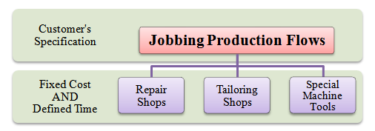
Job production

Slide 28
characteristics job production
The production of items takes place in small lots. Sometimes only one product is produced at one time.
The items are manufactured strictly as per customer's specifications.
Highly skilled labour is required to perform specialized jobs.
There is disproportionate manufacturing cycle time. For e.g. the time needed to design the product may be more than the manufacturing time.

Slide 29
Batch production
In batch production flows, the production schedule is decided according to specific orders or are based on the demand forecasts. Here, the production of items takes place in lots or batches. A product is divided into different jobs. All jobs of one batch of production must be completed before starting the next batch of production.
Examples of batch production flows include, manufacturing of drugs and pharmaceuticals, medium and heavy machineries, etc.

Slide 31
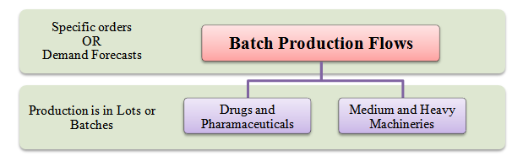

Slide 32
characteristics batch production
The products are made and kept in stock until their demand arises in the market.
General purpose machines and handling equipments, which can do many different jobs quickly are installed. This is because large varieties of items are to be produced.
There is a possibility of large work-in-progress due to many reasons.
There is a need for detailed production planning and control.

